Slide 1

What’s New in Worldview
Zachary Rice

Slide 2
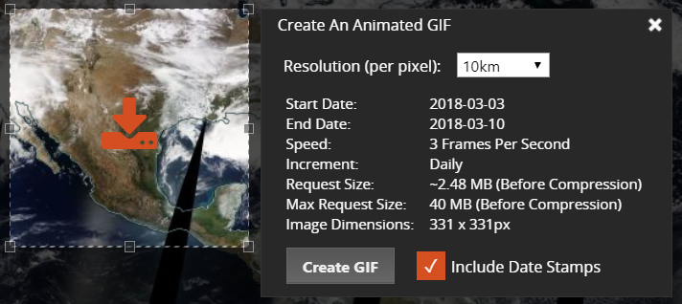



Major Releases
v2.0.0 & v2.1.0
Refactored codebase to use ES6 modules
Simplified build scripts
Improved developer tools (watch mode)
Detect temporal ranges on build
Day of year label on timeline
v2.2.0
Improved GIF resolution
v2.3.0
Subdaily Layer Support
Minute based zoom level
Optimized Layer Requests
v2.4.0 & v2.5.0
Added event tracks to multi-day events
v2.6.0
Added natural events to polar projectors
v2.7.0
Support selecting layers with future dates
v2.8.0 (September 2018)
“A|B” Comparison Mode

Slide 3
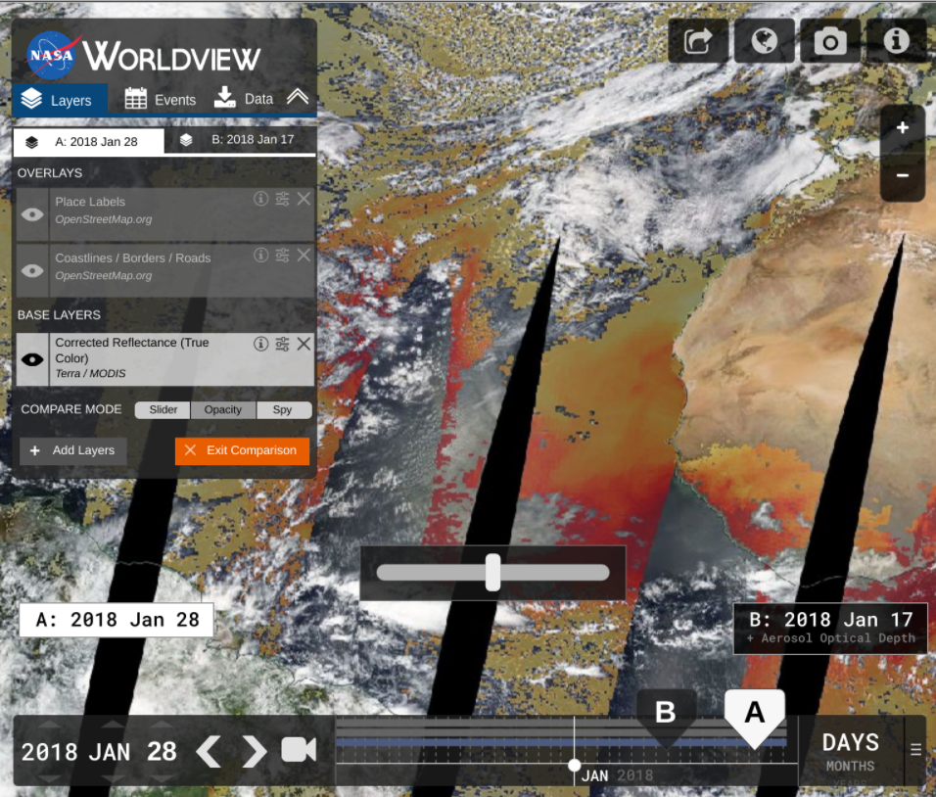
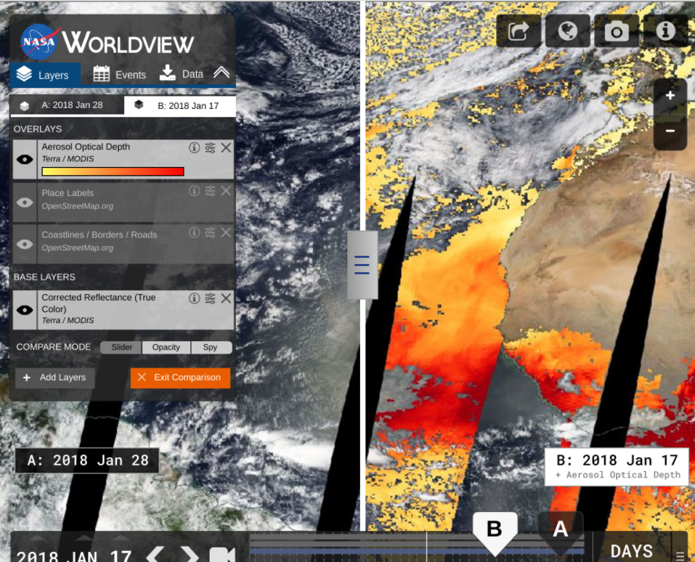
Comparison Mode
http://nasa-gibs.github.io/worldview-design/ab-comparison-final/index.html#start_page

Slide 4
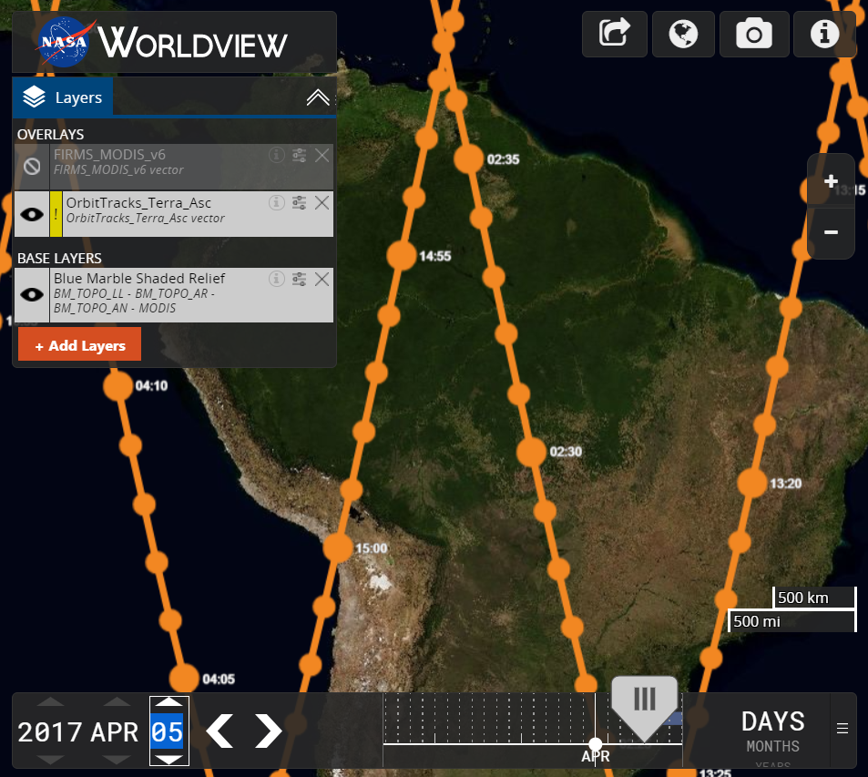
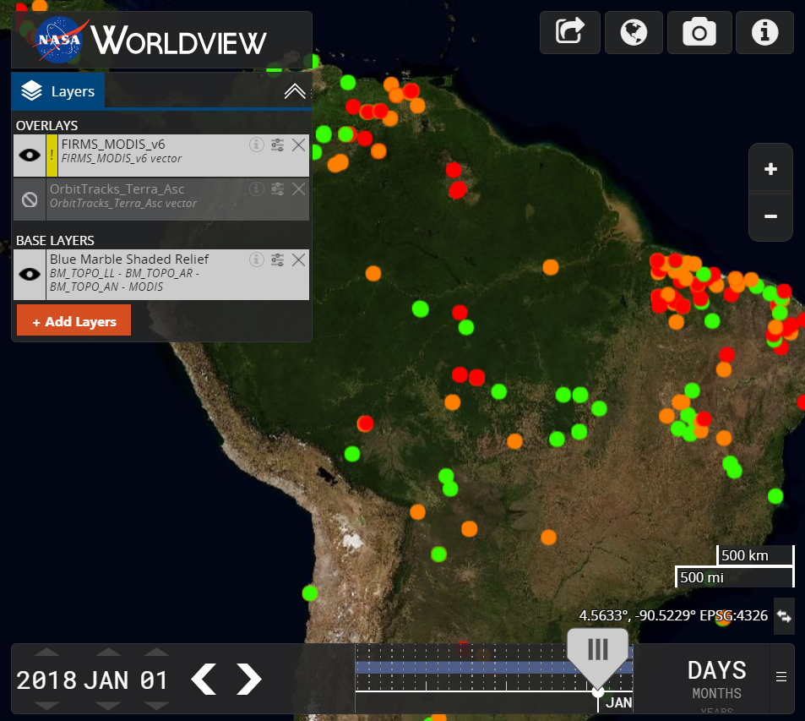
Vector Support

Slide 5
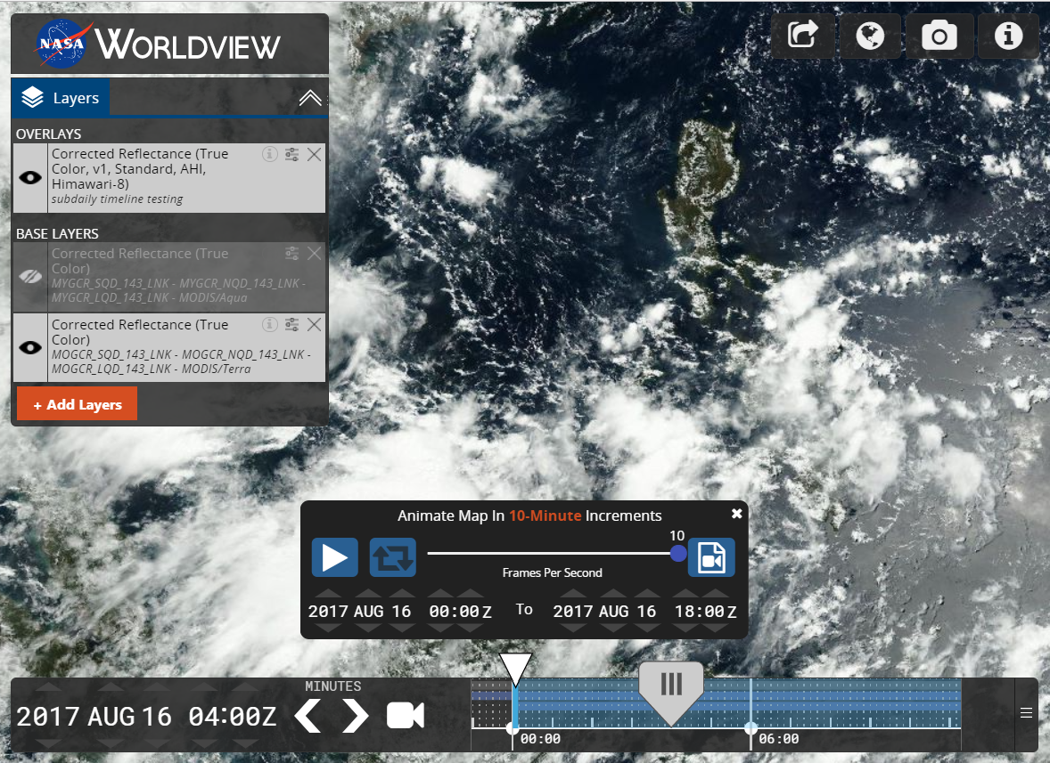
Subdaily Timeline Support
10-Mintue Timeline Zoom

Slide 6
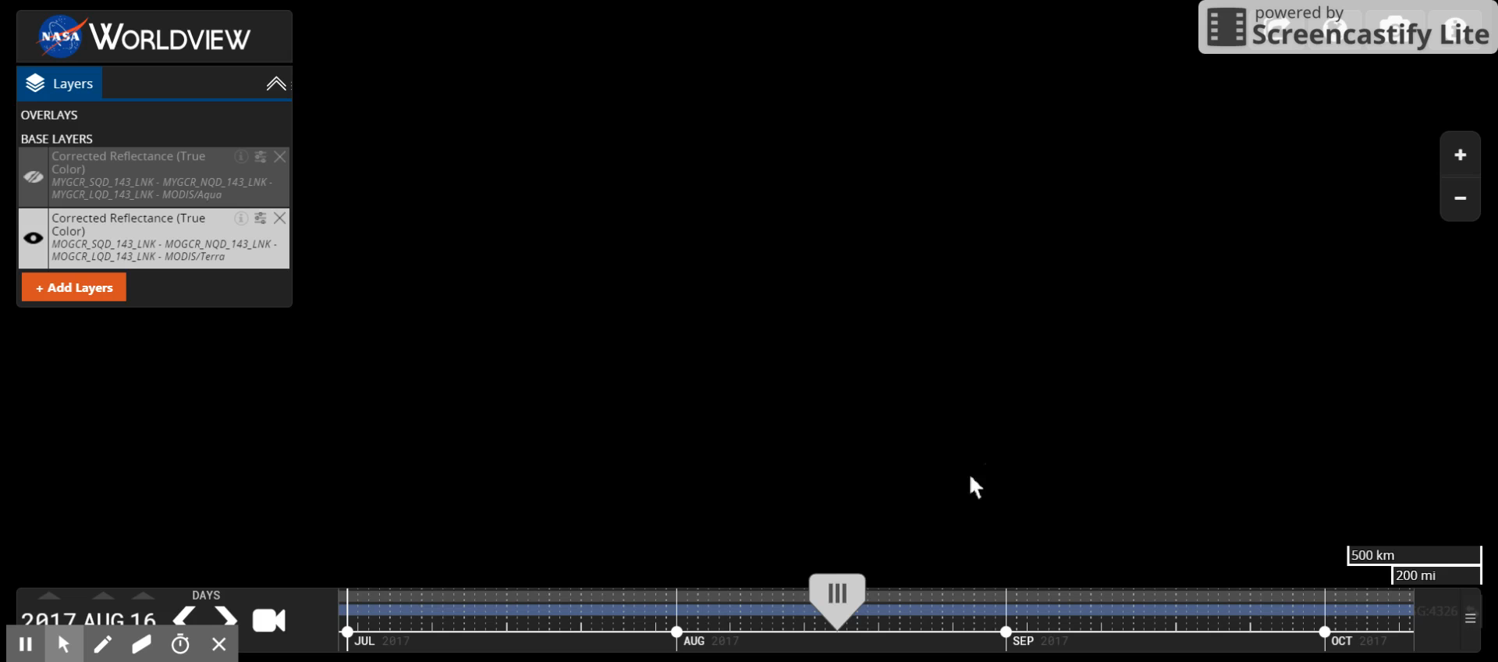
Subdaily Timeline Support

Slide 7
Short-Term Goals
Recruiting more workers!
Senior position has been filled by Mike McGann (4/9)
Mid-level position open: 3 Recent phone screening with 1 promising candidate being interviewed in person when we get back
Sub-daily timeline support
10-Minute
Enhanced vector support
Styling spec implementation
Merge with sub-daily work to support missions

Slide 8
Mid-Term Goals
A|B Comparison
Image download improvements
Capturing imagery across the dateline
Added vector support
Data curtain / virtual globe support
Prepare application for migration to cloud

Slide 9
Long-Term Goals
Gazetteer / Omni search box
Search for places, lat/long, layers
User Customization
Save settings, bookmarks, etc. via Earthdata Login
Add features that support new missions…

